Slide 1
Lecture 10 Sorting 1
EECS-214

Slide 2
The 1900 US Census
Collect information about every person in the united states
Name
Age
Sex
Address
Race
Etc.
Write it all down
Generate statistics
How many people live in each state?
How many elderly are there in a given neighborhood?
How do you tally that sort of data automatically?
(no computers in 1900)

Slide 3
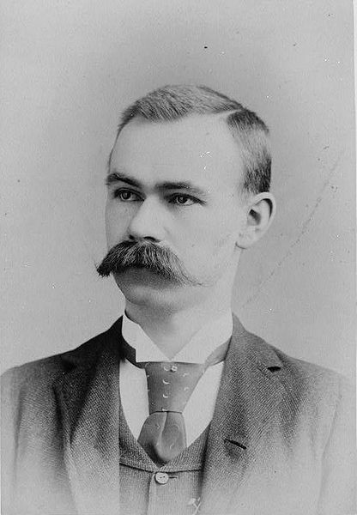
Herman Hollerith
Statistician and engineer working for the census bureau
Invented punch cards
And the technology for processing them electronically
So he started a company to make punch card machines for the government

Slide 4
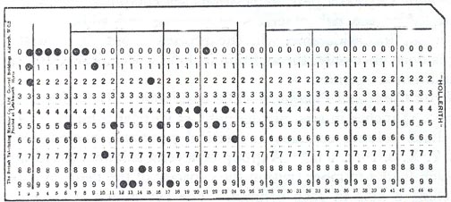
Hollerith cards (later form)
One card per record in the database
80 columns per card
Each column can be punched in one of 12 places
But originally only one hole per column

Slide 5
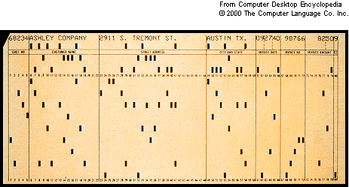
ID#
Name
Street Address
City
Date
Invoice#
$

Slide 6
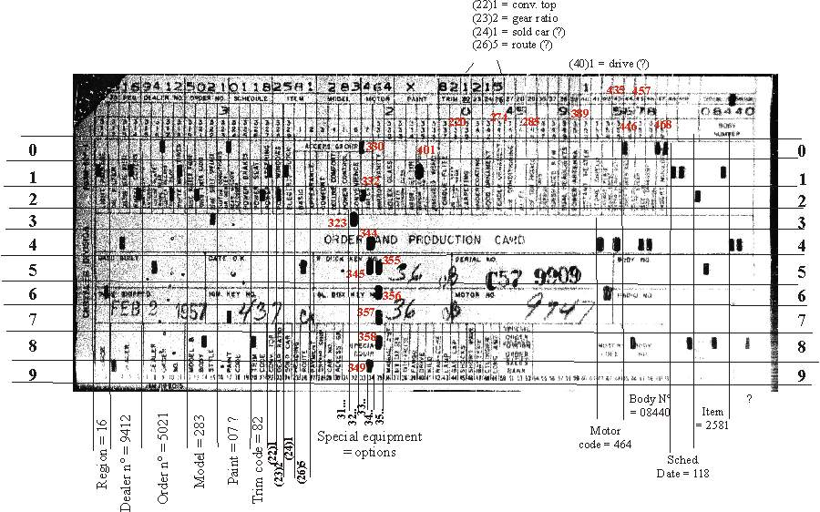

Slide 7
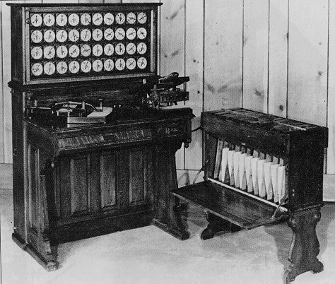
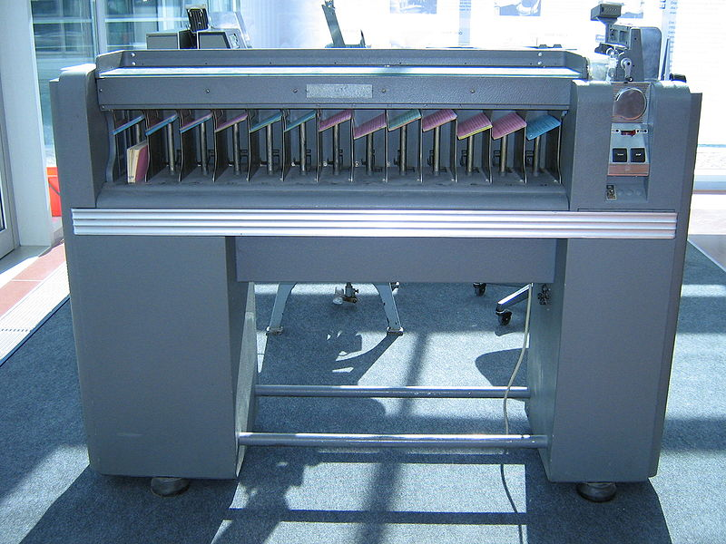
Punch card sorters
Hollerith developed a tabulating machine that would
Count the number of cards with a given pattern of holds in them
Sort the cards into bins based on which hole was punched in a given column

Slide 8
Multi-digit sorting
What the #$% can you do with a machine that sorts on just one column?
What if you have a bunch of cards with 3 digit numbers punched on them and you want to sort them into order?
Unsorted numbers:
345
085
024
978
432
074
001
247
082

Slide 9
Radix sort: The (arguably) first cool algorithm
First sort them by their last digit
This is the basic operation of the card sorter
Unsorted numbers:
345
085
024
978
432
074
001
247
082

Slide 10
Radix sort: The (arguably) first cool algorithm
First sort them by their last digit
Great. They’re sorted by the last digit. Now what?
Sorted numbers:
001
432
082
024
074
345
085
247
978

Slide 11
Radix sort: The (arguably) first cool algorithm
First sort them by their last digit
Now take all the cards from all the bins, in order
Sorted numbers:
001
432
082
024
074
345
085
247
978

Slide 12
Radix sort: The (arguably) first cool algorithm
First sort them by their last digit
Now take all the cards from all the bins, in order
And sort them by their middle digit
The card sorter preserves the order of cards with the same middle digit
Sorted numbers:
001
432
082
024
074
345
085
247
978

Slide 13
Radix sort: The (arguably) first cool algorithm
First sort them by their last digit
Now take all the cards from all the bins, in order
And sort them by their middle digit
Presto! The cards are now sorted by the last two digits
Sorted numbers:
001
024
432
345
247
074
978
082
085

Slide 14
Radix sort: The (arguably) first cool algorithm
First sort them by their last digit
Now take all the cards from all the bins, in order
And sort them by their middle digit
And, finally, resort by the first digit
Sorted numbers:
001
024
432
345
247
074
978
082
085

Slide 15
Radix sort: The (arguably) first cool algorithm
First sort them by their last digit
Now take all the cards from all the bins, in order
And sort them by their middle digit
And, finally, resort by the first digit
Sorted numbers:
001
024
074
082
085
247
345
432
978

Slide 16
Radix sort: The (arguably) first cool algorithm
First sort them by their last digit
Now take all the cards from all the bins, in order
And sort them by their middle digit
And, finally, resort by the first digit
They’re now properly sorted by numerical value
Sorted numbers:
001
024
074
082
085
247
345
432
978

Slide 17
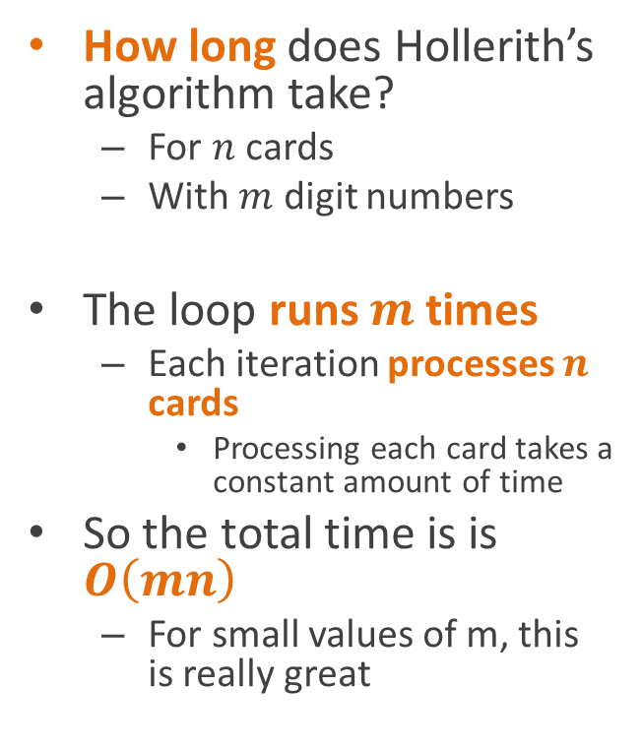
Analysis
How long does Hollerith’s algorithm take?
For $n$ cards
With $m$ digit numbers
The loop runs $m$ times
Each iteration processes $n$ cards
Processing each card takes a constant amount of time
So the total time is is $O\left(mn\right)$
For small values of m, this is really great
For each digit (in reverse order):
Sort cards into bins (based only on that digit)
Merge cards into one stack

Slide 18
A company built on card sorting
Hollerith’s company was very successful
It eventually merged with some other companies

Slide 19

A company built on card sorting
Hollerith’s company was very successful
It eventually merged with some other companies and renamed itself “International Business Machines”

Slide 20
sorting is kind of a big deal in computing …

Slide 21
Sort algorithms
Most of the time, radix sort isn’t appropriate
Don’t know number of digits in advance
Sorting things that aren’t numbers to begin with
Sorting algorithms have been extensively studied in computer science
And now you get to extensively study them too!
91
77
12
52
36
0

Slide 22
Sort algorithms
Most sort algorithms
Take an array as input
And rewrite the array in place
To produce a sorted array with the same data
The trick is to design an algorithm that scales well as the size of the array increases
91
77
12
52
36
0

Slide 23
Selection sort
The worst possible sort algorithm
Find the smallest element
91
77
12
52
36
0

Slide 24
Selection sort
The worst possible sort algorithm
Find the smallest element
Swap it with the first element
0
77
12
52
36
91

Slide 25
Selection sort
The worst possible sort algorithm
Find the smallest element
Swap it with the first element
Find the next smallest element
0
77
12
52
36
91

Slide 26
Selection sort
The worst possible sort algorithm
Find the smallest element
Swap it with the first element
Find the next smallest element
Swap it with the second element
0
12
77
52
36
91

Slide 27
Selection sort
The worst possible sort algorithm
Repeat for the rest of the elements
0
12
77
52
36
91

Slide 28
Selection sort
The worst possible sort algorithm
Repeat for the rest of the elements
0
12
36
52
77
91

Slide 29
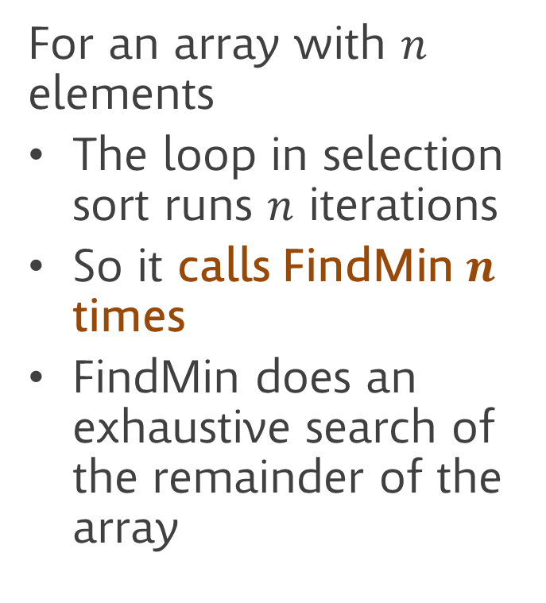
Why does selection sort suck?
For an array with $n$ elements
The loop in selection sort runs $n$ iterations
So it calls FindMin $n$ times
FindMin does an exhaustive search of the remainder of the array
SelectionSort(a)
for (i=0; i<a.Length; i++)
index = FindMin(a, i)
swap a[i] and a[index]
FindMin(a, start)
minIndex = start
minValue = a[start]
for (i=start+1; i<a.Length; i++)
if a[i]<minValue
minValue = a[i]
minIndex = I
return minIndex

Slide 30
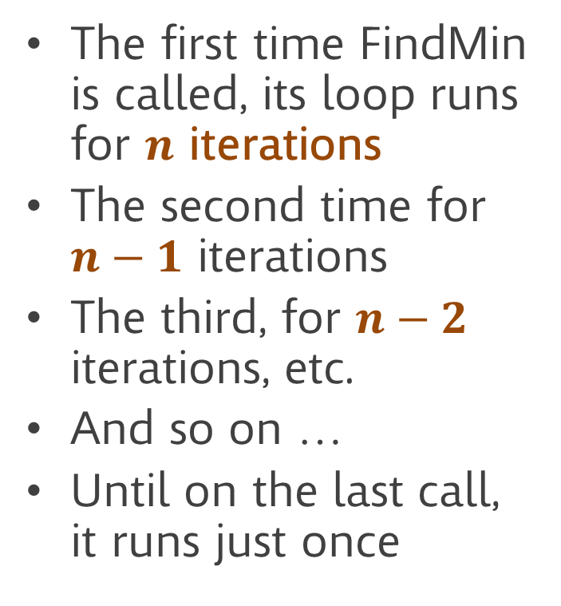
Why does selection sort suck?
The first time FindMin is called, its loop runs for $n$ iterations
The second time for $n−1$ iterations
The third, for $n−2$ iterations, etc.
And so on …
Until on the last call, it runs just once
SelectionSort(a)
for (i=0; i<a.Length; i++)
index = FindMin(a, i)
swap a[i] and a[index]
FindMin(a, start)
minIndex = start
minValue = a[start]
for (i=start+1; i<a.Length; i++)
if a[i]<minValue
minValue = a[i]
minIndex = I
return minIndex

Slide 31
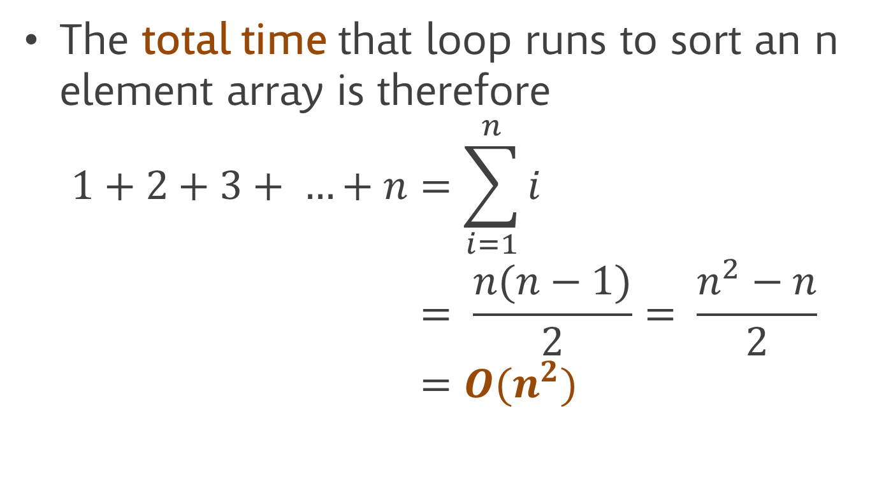
Why does selection sort suck?
The total time that loop runs to sort an n element array is therefore
$$1+2+3+ …+n=\sum_{i=1}^{n}{i} \\ = \frac{n(n−1)}{2}= \frac{n^{2}−n}{2} \\ =O(n^{2})$$

Slide 32
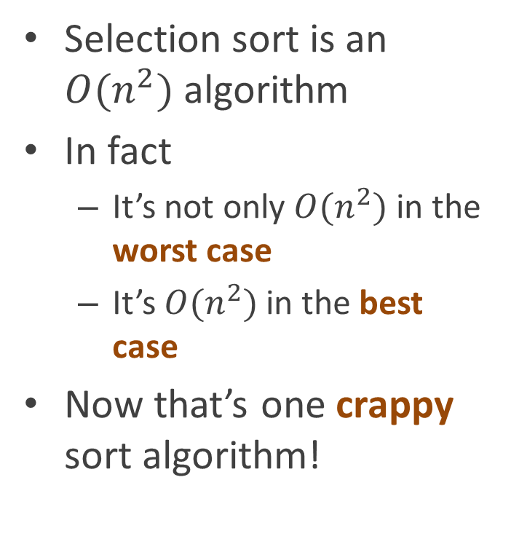
Why does selection sort suck?
Selection sort is an $O(n^{2})$ algorithm
In fact
It’s not only $O(n^{2})$ in the worst case
It’s $O(n^{2})$ in the best case
Now that’s one crappy sort algorithm!
SelectionSort(a)
for (i=0; i<a.Length; i++)
index = FindMin(a, i)
swap a[i] and a[index]
FindMin(a, start)
minIndex = start
minValue = a[start]
for (i=start+1; i<a.Length; i++)
if a[i]<minValue
minValue = a[i]
minIndex = I
return minIndex

Slide 33
Insertion sort: A somewhat less crappy algorithm
Basic idea
Divide the array into two parts
The beginning of the array is sorted
The end of the array is unsorted
Declare the first element of the array to be a one-element sorted section
Repeat until done
Move one element
From the unsorted part
To the sorted part
Placing it in the correct location
0
12
77
52
36
91
sorted
unsorted

Slide 34
Insertion sort: A somewhat less crappy algorithm
InsertionSort(a)
for (i=1; i<a.length; i++)
Insert(a, i, a[i])
Insert(a, position, value)
// Copy elements forward
// until you find one less than value
for (i=pos-1; i≥0 && a[i]>value; i--)
a[i+1] = a[i]
// Put value in the hole you created
a[i+1] = value
0
12
77
52
36
91
sorted
unsorted

Slide 35
Inserting an element
value=36
InsertionSort(a)
for (i=1; i<a.length; i++)
Insert(a, i, a[i])
Insert(a, position, value)
// Copy elements forward
// until you find one less than value
for (i=pos-1; i≥0 && a[i]>value; i--)
a[i+1] = a[i]
// Put value in the hole you created
a[i+1] = value
0
12
52
77
36
91
sorted
unsorted

Slide 36
Inserting an element
value=36
Start here
InsertionSort(a)
for (i=1; i<a.length; i++)
Insert(a, i, a[i])
Insert(a, position, value)
// Copy elements forward
// until you find one less than value
for (i=pos-1; i≥0 && a[i]>value; i--)
a[i+1] = a[i]
// Put value in the hole you created
a[i+1] = value
0
12
52
77
36
91
sorted
unsorted

Slide 37
Inserting an element
value=36
Too big
InsertionSort(a)
for (i=1; i<a.length; i++)
Insert(a, i, a[i])
Insert(a, position, value)
// Copy elements forward
// until you find one less than value
for (i=pos-1; i≥0 && a[i]>value; i--)
a[i+1] = a[i]
// Put value in the hole you created
a[i+1] = value
0
12
52
77
36
91
sorted
unsorted

Slide 38
Inserting an element
value=36
Copy to next cell
InsertionSort(a)
for (i=1; i<a.length; i++)
Insert(a, i, a[i])
Insert(a, position, value)
// Copy elements forward
// until you find one less than value
for (i=pos-1; i≥0 && a[i]>value; i--)
a[i+1] = a[i]
// Put value in the hole you created
a[i+1] = value
0
12
52
77
36
91
sorted
unsorted

Slide 39
Inserting an element
value=36
Copy to next cell
InsertionSort(a)
for (i=1; i<a.length; i++)
Insert(a, i, a[i])
Insert(a, position, value)
// Copy elements forward
// until you find one less than value
for (i=pos-1; i≥0 && a[i]>value; i--)
a[i+1] = a[i]
// Put value in the hole you created
a[i+1] = value
0
12
52
77
77
91
sorted
unsorted

Slide 40
Inserting an element
value=36
Try the previous cell
InsertionSort(a)
for (i=1; i<a.length; i++)
Insert(a, i, a[i])
Insert(a, position, value)
// Copy elements forward
// until you find one less than value
for (i=pos-1; i≥0 && a[i]>value; i--)
a[i+1] = a[i]
// Put value in the hole you created
a[i+1] = value
0
12
52
77
77
91
sorted
unsorted

Slide 41
Inserting an element
value=36
Still too big
InsertionSort(a)
for (i=1; i<a.length; i++)
Insert(a, i, a[i])
Insert(a, position, value)
// Copy elements forward
// until you find one less than value
for (i=pos-1; i≥0 && a[i]>value; i--)
a[i+1] = a[i]
// Put value in the hole you created
a[i+1] = value
0
12
52
77
77
91
sorted
unsorted

Slide 42
Inserting an element
value=36
Copy
InsertionSort(a)
for (i=1; i<a.length; i++)
Insert(a, i, a[i])
Insert(a, position, value)
// Copy elements forward
// until you find one less than value
for (i=pos-1; i≥0 && a[i]>value; i--)
a[i+1] = a[i]
// Put value in the hole you created
a[i+1] = value
0
12
52
77
77
91
sorted
unsorted

Slide 43
Inserting an element
value=36
Copy
InsertionSort(a)
for (i=1; i<a.length; i++)
Insert(a, i, a[i])
Insert(a, position, value)
// Copy elements forward
// until you find one less than value
for (i=pos-1; i≥0 && a[i]>value; i--)
a[i+1] = a[i]
// Put value in the hole you created
a[i] = value
0
12
52
52
77
91
sorted
unsorted

Slide 44
Inserting an element
value=36
Try the previous cell
InsertionSort(a)
for (i=1; i<a.length; i++)
Insert(a, i, a[i])
Insert(a, position, value)
// Copy elements forward
// until you find one less than value
for (i=pos-1; i≥0 && a[i]>value; i--)
a[i+1] = a[i]
// Put value in the hole you created
a[i+1] = value
0
12
52
52
77
91
sorted
unsorted

Slide 45
Inserting an element
value=36
Try the previous cell
InsertionSort(a)
for (i=1; i<a.length; i++)
Insert(a, i, a[i])
Insert(a, position, value)
// Copy elements forward
// until you find one less than value
for (i=pos-1; i≥0 && a[i]>value; i--)
a[i+1] = a[i]
// Put value in the hole you created
a[i+1] = value
0
12
52
52
77
91
sorted
unsorted

Slide 46
Inserting an element
value=36
Not too big
InsertionSort(a)
for (i=1; i<a.length; i++)
Insert(a, i, a[i])
Insert(a, position, value)
// Copy elements forward
// until you find one less than value
for (i=pos-1; i≥0 && a[i]>value; i--)
a[i+1] = a[i]
// Put value in the hole you created
a[i+1] = value
0
12
52
52
77
91
sorted
unsorted

Slide 47
Inserting an element
value=36
Place value in next cell
InsertionSort(a)
for (i=1; i<a.length; i++)
Insert(a, i, a[i])
Insert(a, position, value)
// Copy elements forward
// until you find one less than value
for (i=pos-1; i≥0 && a[i]>value; i--)
a[i+1] = a[i]
// Put value in the hole you created
a[i+1] = value
0
12
52
52
77
91
sorted
unsorted

Slide 48
Inserting an element
value=36
Finished insertion!
InsertionSort(a)
for (i=1; i<a.length; i++)
Insert(a, i, a[i])
Insert(a, position, value)
// Copy elements forward
// until you find one less than value
for (i=pos-1; i≥0 && a[i]>value; i--)
a[i+1] = a[i]
// Put value in the hole you created
a[i+1] = value
0
12
36
52
77
91
sorted
unsorted

Slide 49
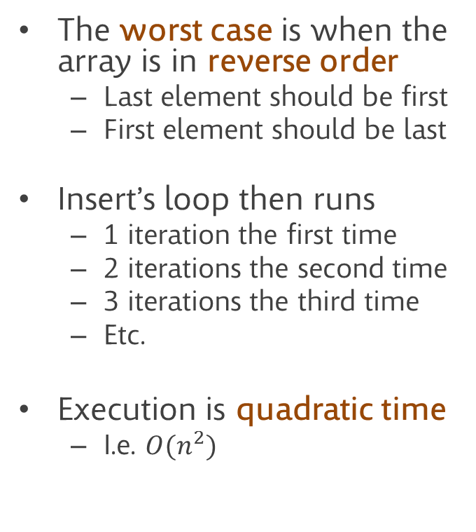
Worst-case analysis
The worst case is when the array is in reverse order
Last element should be first
First element should be last
Insert’s loop then runs
1 iteration the first time
2 iterations the second time
3 iterations the third time
Etc.
Execution is quadratic time
I.e. $O(n^{2})$
InsertionSort(a)
for (i=1; i<a.length; i++)
Insert(a, i, a[i])
Insert(a, position, value)
for (i=pos-1; i≥0 && a[i]>value; i--)
a[i+1] = a[i]
a[i+1] = value

Slide 50
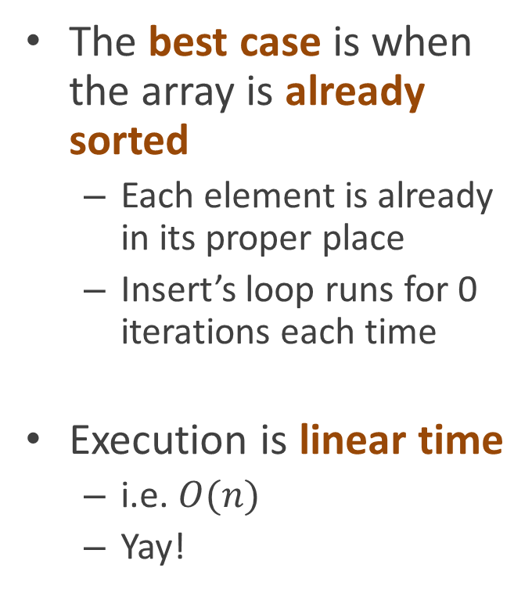
Best-case analysis
The best case is when the array is already sorted
Each element is already in its proper place
Insert’s loop runs for 0 iterations each time
Execution is linear time
i.e. $O(n)$
Yay!
InsertionSort(a)
for (i=1; i<a.length; i++)
Insert(a, i, a[i])
Insert(a, position, value)
for (i=pos-1; i≥0 && a[i]>value; i--)
a[i+1] = a[i]
a[i+1] = value

Slide 51

Average-case analysis
Sadly, the average-case performance is still quadratic – $O\left(n^{2}\right)$
Although we won’t prove it in class
InsertionSort(a)
for (i=1; i<a.length; i++)
Insert(a, i, a[i])
Insert(a, position, value)
for (i=pos-1; i≥0 && a[i]>value; i--)
a[i+1] = a[i]
a[i+1] = value

Slide 52
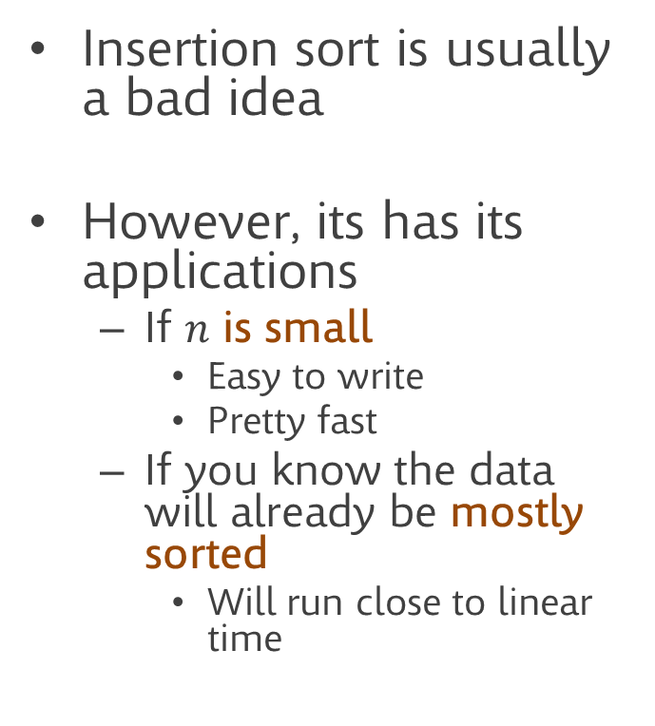
Performance
Insertion sort is usually a bad idea
However, its has its applications
If $n$ is small
Easy to write
Pretty fast
If you know the data will already be mostly sorted
Will run close to linear time
InsertionSort(a)
for (i=1; i<a.length; i++)
Insert(a, i, a[i])
Insert(a, position, value)
for (i=pos-1; i≥0 && a[i]>value; i--)
a[i+1] = a[i]
a[i+1] = value

Slide 53
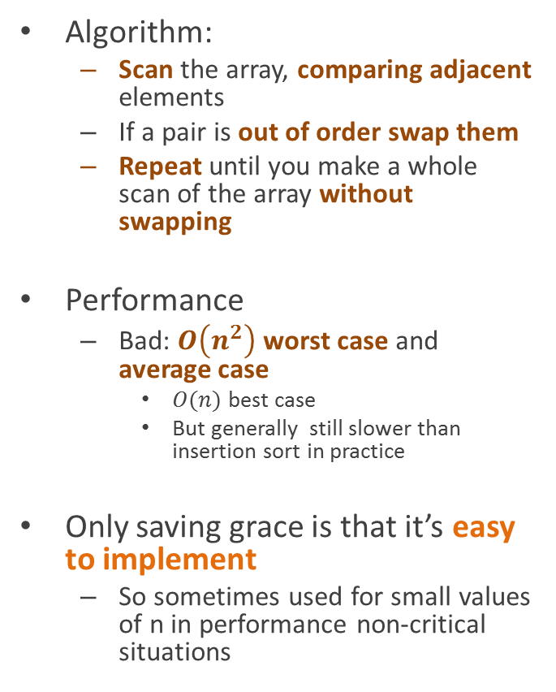
Bubble sort (aka “bogosort”): When you don’t care enough to send the very best
Algorithm:
Scan the array, comparing adjacent elements
If a pair is out of order swap them
Repeat until you make a whole scan of the array without swapping
Performance
Bad: $O\left(n^{2}\right)$ worst case and average case
$O(n)$ best case
But generally still slower than insertion sort in practice
Only saving grace is that it’s easy to implement
So sometimes used for small values of n in performance non-critical situations
BubbleSort(a)
swapped = true
while swapped
swapped = false
for (i=0; i<a.Length-1; i++)
if (a[i]>a[i+1]) swap a[i] and a[i+1]
swapped = true

Slide 54
next: sorts that don’t suck

